Slide 1



Workshop
The donors' prioritization matrix
Targeting accurately: the key to maximizing your chances of success

Slide 2

Agenda
Key prioritization criteria
Presentation of the matrix
Some tips
Your turn! Exercise

Slide 3

Key criteria
Strategic alignment
Funds available
  Sectors
  Geographic areas
  Grants size
  Co-financing

Slide 4
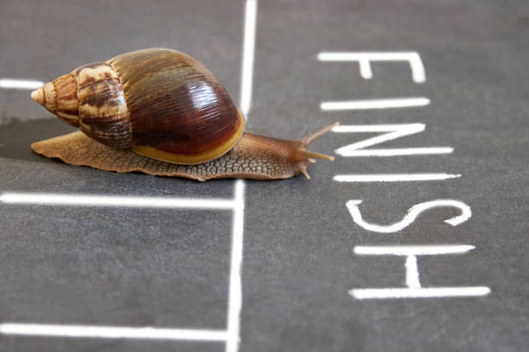



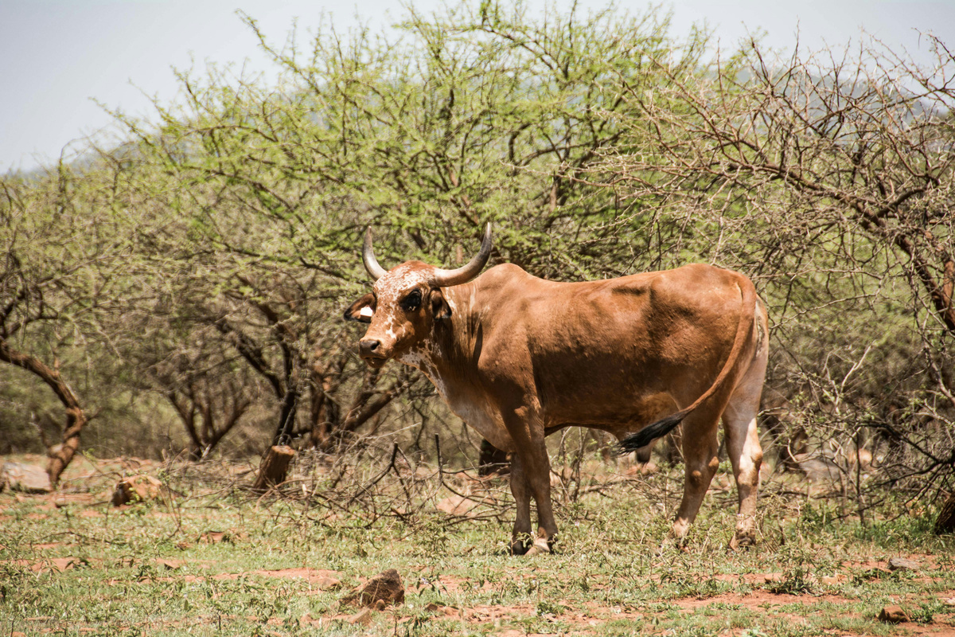
The prioritization matrix
Outsider
Rockstar
Donors with significant funding and whose priorities are closely aligned with those of the organization
Donors with limited funding but whose priorities are strongly aligned with those of the organization.
Prioritize in the long term / keep under review
Prioritize in the short/medium term
Strategic alignment
Dead weight
Cash cow
Donors with limited funds and whose priorities differ from those of the organization
Donors with significant funding but whose priorities differ from those of the organization
Give up quickly
Gradually phase out
Funds available

Slide 5

Some tips
  Reuse the elements of the donor mapping
  Prioritize decision-making based on verified data (beware of rumors).
  Making difficult decisions together. For example, classifying a donor as a "cash cow" and gradually ending the relationship.

Slide 6
Up to you!
Outsider
Rockstar
Strategic alignment
Dead weight
Cash cow
Funds available

